Slide 1
Integrated Curriculum
Kathryn Spruiell
American College of Education
CI6103 – Curriculum and Instruction Design for Diversity
Dr. T. Hinchman
May 21, 2023

Slide 2
The Lesson: Fourth Grade Social Studies – The Declaration of Independence - Standards
The lesson incorporated state and district social studies standards for understanding the Declaration of Independence.
Georgia - SS4H1 Explain the causes, events, and results of the American Revolution.
d. Explain the writing of the Declaration of Independence; include who wrote it, how it was written, why it was necessary, and how it was a response to tyranny and the abuse of power (GADOE, 2023).
Gwinnett County Public Schools –
AKS: 4SS.C.30.d: explain the main idea (the writing) of the Declaration of Independence; include who wrote it, how it was written, the sequence of events that explain why it was necessary, and how it was a "cause and effect" response to tyranny and the abuse of power (GCPS, 2023 a-b).
Notes:
Create an outline to get ready:
Introduce the era (Use a mix of media and text)
Organize your artifacts to outline what life was like during the era you are presenting
Think about using a storyboard to outline your images and ideas
Make sure you prepare a clear and well rounded presentation of all aspects of the era (People, jobs, food, transportation, etc. What else should you include so the audience feels like they have visited your era?)

Slide 3
The Lesson: Fourth Grade Social Studies – The Declaration of Independence – Teacher and Student Actions
The lesson integrates social studies and writing across the curriculum.
Activating strategy – Watch a video from the Broadway play, “Hamilton.”
Discuss background knowledge about the reasons and context for the Declaration of Independence.
Complete Writing Prompt:
Writing Prompt –
Great Britain thought it was disloyal and treasonous to declare their independence. Write an argument disagreeing with Great Britain’s point of view. Use what you have learned about the Declaration of Independence (such as natural rights, the grievances, and the big ideas of the document) to explain why it is a necessary response on behalf of colonists (GCPS, 2023a).
Notes:
Create an outline to get ready:
Introduce the era (Use a mix of media and text)
Organize your artifacts to outline what life was like during the era you are presenting
Think about using a storyboard to outline your images and ideas
Make sure you prepare a clear and well rounded presentation of all aspects of the era (People, jobs, food, transportation, etc. What else should you include so the audience feels like they have visited your era?)

Slide 4
The Lesson: Fourth Grade Social Studies – The Declaration of Independence – Instructional Considerations for Diverse Learners
The lesson integrated strategies for equitable access by diverse learner groups – ELL, SWD, GT
Consider giving ELL students sentence stems or paragraph frames.
Allow ELL and SPED students to use notes, passages, or other instructional items from the unit to help with their writing piece.
Provide ELL and SPED students with graphic organizers to draft and edit their writing.
Provide ELL and SPED students with visual study materials for key vocabulary, both digital and print.
Meet with ELL and SPED students in small groups and use a gradual release cycle to model differentiated strategies in multiple modalities (Visual, Auditory, Kinesthetic), both digital and print.
Apply a flipped approach with gifted learners to preview and research learning and allow the students opportunities to serve as a peer leader for other students.
Give gifted students more choice in their writing topic to craft writing pieces for both points of view.
Have gifted students conduct a debate representing both points of view for colonial taxation.
Modifications: Reduce the length of the writing requirement to 1-2 paragraphs containing the same content, provide paragraph organizers (Oreo Writing graphic organizer) for students to complete prior to writing; facilitate the process for a small group of struggling learners; assign peer partners; allow students to type, record, or dictate their paragraphs; provide sentence starters for each paragraph (GADOE, 2023).
Notes:
Create an outline to get ready:
Introduce the era (Use a mix of media and text)
Organize your artifacts to outline what life was like during the era you are presenting
Think about using a storyboard to outline your images and ideas
Make sure you prepare a clear and well rounded presentation of all aspects of the era (People, jobs, food, transportation, etc. What else should you include so the audience feels like they have visited your era?)

Slide 5
The Lesson: Fourth Grade Social Studies – The Declaration of Independence – Integrating On-line Learning -Part 1
The lesson is combined with another district lesson plan that uses music videos from You Tube to help students gain a deeper understanding of why the colonies wanted to sever relations with Great Britain.
Students explore music videos through the district’s student portal using the Safari Montage platform (GCPS, 2023b).
The lesson includes a Taylor Smith video and lyrics analysis of her song, “We are Never Getting Back Together” (GCPS, 2023b).
https://www.youtube.com/embed/n2Ez-w-zvd4?modestbranding=1&autoplay=1&iv_load_policy=3&rel=0&fs=1&start=&end=
The lesson also includes a parody video about the Declaration of Independence to the OneRepublic song, “Apologize.”
https://www.youtube.com/watch?v=uZfRaWAtBVg&list=RDuZfRaWAtBVg&start_radio=1
The students analyze the lyrics and make connections to the reasons why the founding fathers decided to declare independence and describe exactly what that means.
Notes:
Create an outline to get ready:
Introduce the era (Use a mix of media and text)
Organize your artifacts to outline what life was like during the era you are presenting
Think about using a storyboard to outline your images and ideas
Make sure you prepare a clear and well rounded presentation of all aspects of the era (People, jobs, food, transportation, etc. What else should you include so the audience feels like they have visited your era?)

Slide 6
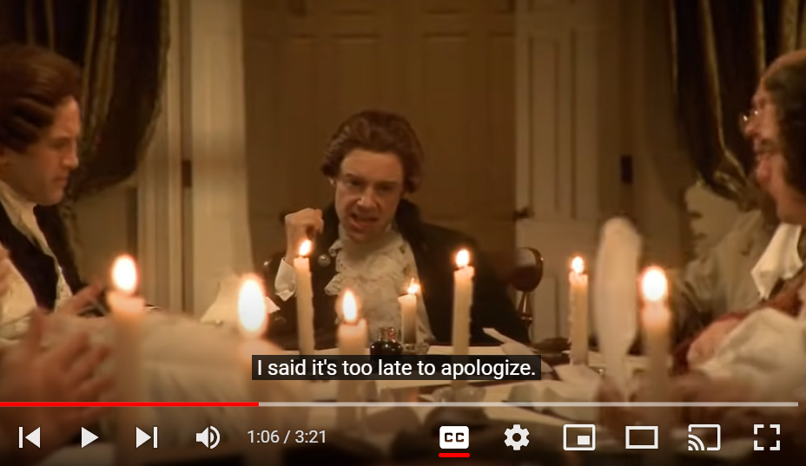
The Lesson: Fourth Grade Social Studies – The Declaration of Independence – No More Kings
https://www.soomolearning.com/declaration#lyrics
“The following video is an anachronistic daydream asking the question, "If pop producer Timbaland had sought to build consensus around declaring independence, what might he have produced?"
If you (like everyone at Soomo over 35) aren't familiar with the original video that prompted this parody, "Apologize" by OneRepublic went to number one in 16 countries in a remix by Timbaland “ (Soomo, 2023, webpage).
Lyrics
Halfway across the globe And we're standing on new ground Screaming 'cross the waves You can't hear a sound There's no fair trials, no trade, no liberties No tea We've colonized America; we won't stand for tyranny, Oh king
And it's too late to apologize It's too late I said it's too late to apologize It's too late
We've paid your foolish tax, read the acts And they just won't do We want to make it clear we believe this much is true All men were created with certain Unalienable rights Among these are life, liberty, and the pursuit Of happiness
And it's too late to apologize It's too late I said It's too late to apologize It's too late
Notes:
Create an outline to get ready:
Introduce the era (Use a mix of media and text)
Organize your artifacts to outline what life was like during the era you are presenting
Think about using a storyboard to outline your images and ideas
Make sure you prepare a clear and well rounded presentation of all aspects of the era (People, jobs, food, transportation, etc. What else should you include so the audience feels like they have visited your era?)

Slide 7
The Lesson: Fourth Grade Social Studies – The Declaration of Independence – Integrating On-line Learning - Part 2
The students work in small groups to create their own song lyrics to a song of their choice about the Declaration of Independence.
Learning Target: I can explain the writing of the Declaration of Independence; including who wrote it and how it was a necessary response to tyranny and abuse of power (GCPS, 2023 a-b).
Students create their song lyrics to create a presentation in Google Classroom.
Students may use Google Slides and add video and pictures to their presentations, or they can create a music video of their songs.
Students use a rubric to make sure their presentations follow guidelines and meet expectations.
The on-line integration is a multimodal strategy that engages students visual and auditory learning modalities with another writing genre: poetry (song lyrics).
Students present their finished products to the class.
Notes:
Create an outline to get ready:
Introduce the era (Use a mix of media and text)
Organize your artifacts to outline what life was like during the era you are presenting
Think about using a storyboard to outline your images and ideas
Make sure you prepare a clear and well rounded presentation of all aspects of the era (People, jobs, food, transportation, etc. What else should you include so the audience feels like they have visited your era?)

Slide 8
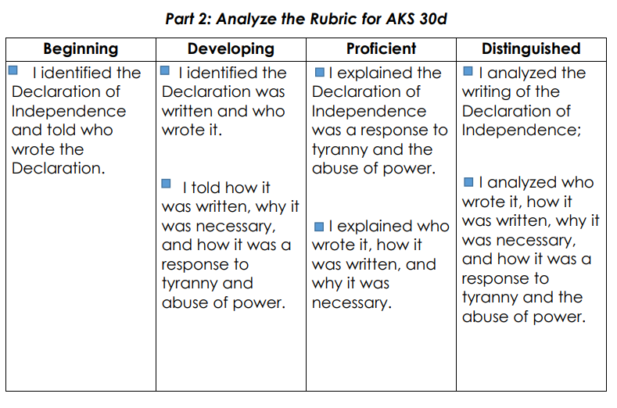
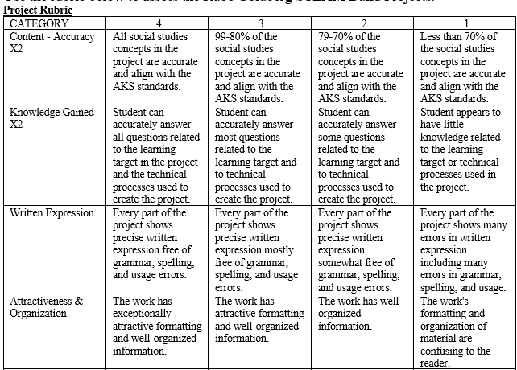
The Lesson: Fourth Grade Social Studies – The Declaration of Independence – Assessment
(GCPS, 2023 a)
Notes:
Create an outline to get ready:
Introduce the era (Use a mix of media and text)
Organize your artifacts to outline what life was like during the era you are presenting
Think about using a storyboard to outline your images and ideas
Make sure you prepare a clear and well rounded presentation of all aspects of the era (People, jobs, food, transportation, etc. What else should you include so the audience feels like they have visited your era?)

Slide 9
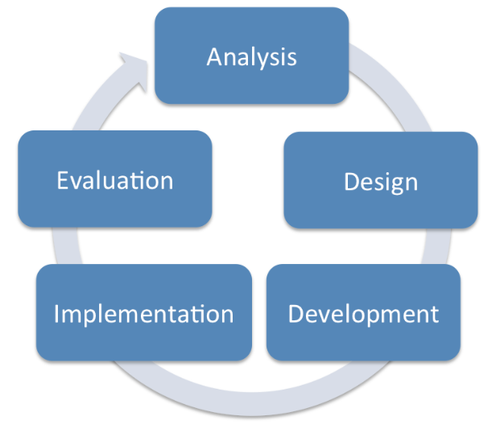
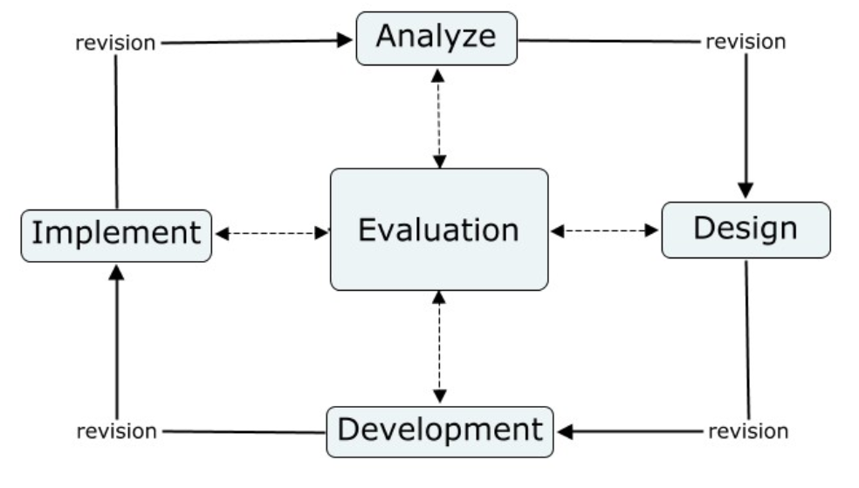
The ADDIE Framework
Analysis – Goal Setting/Learning Outcomes– What do students need to know? Choose appropriate on-line tools, materials, and resources for student needs
Design – Systematic approach to determining the details and planning of the instructional elements
Development – Create the Lesson Plan using the tools and materials collected
Implementation – Carryout the lesson plan and gather feedback for continuous improvement.
Evaluate - Use formative and summative assessment to evaluate the student outcomes.
(Educational Technology, 2023)
(West et al., 2016)

Slide 10
Reflection: ADDIE in Action in the Lesson
ADDIE (Lesson strengths and weaknesses) | Analyze | Design | Development | Implementation | Evaluate
Lesson effectiveness for meeting State and District Standards | -Begin with the end in mind – focus on the standards. -Select tools and strategies appropriate to the grade level, age, and development readiness of the learners. | -Lessons are developed using research-based strategies at the district and state level (GADOE, 2023; GCPS, 2023 a-b). | -Original lessons included opportunities for on-line integration -Seize opportunities to add more in real-time (GCPS, 2023 a-b). | - All parts of the lesson relate learning strategies to the standards. The lesson tools support student understanding on content knowledge (GCPS, 2023 a-b). | - Students and teachers use rubrics at the beginning and end of the lesson that come back to the standards (GCPS, 2023 a-b).
Addressing students’ diverse and sociocultural needs | -Select tools, strategies and rubrics that meet diverse student needs. Scaffolding for SWD and ELL Extension for GT | - Lessons utilize multimodal strategies and rubrics. -An additional rubric is added to capture student creativity. | - Small group learning - Google Classroom and You Tube links -VAK multimodal strategies - WAC strategies -Appropriate Rubrics (GCPS, 2023 a-b). | - The implementation includes scaffolds and extensions for diverse learners with multiple access points (GCPS, 2023 a-b). - A growth opportunity is to observe and find more access points. | - The Rubrics are standards focused but include opportunities for multimodal strategies. - Formative and summative opportunities (GCPS, 2023 a-b)
Notes:
Create an outline to get ready:
Introduce the era (Use a mix of media and text)
Organize your artifacts to outline what life was like during the era you are presenting
Think about using a storyboard to outline your images and ideas
Make sure you prepare a clear and well rounded presentation of all aspects of the era (People, jobs, food, transportation, etc. What else should you include so the audience feels like they have visited your era?)

Slide 11
References
Educational Technology (2023). ADDIE model: Instructional design. https://educationaltechnology.net/the-addie-model-instructional-design/
Georgia Department of Education. (2023). Fourth grade frameworks for the Georgia standards of excellence in social studies: Fourth grade social studies unit 2 forming a new nation. https://lor2.gadoe.org/gadoe/file/c1f38697-6658-405d-8b90-b96a35a94cb4/1/Social-Studies-4th-Grade-Unit-2-Sample-Unit.pdf
Gwinnett County Public Schools. (2023a). GCPS C&I lesson plan: 4SS writing freedom lesson AKS 30d. https://docs.google.com/document/d/1GdgCEA3xI-HY39RTGCo2mpR6JV_-FQPw3BXD5i20AX0/edit#heading=h.gjdgxs
Gwinnett County Public Schools. (2023b). GCPS C&I lesson plan: 4SS Declaring an End AKS 30d. https://docs.google.com/document/d/1POrkNub1maeOBpxqKV7pa-xLAZpbZjuHiTgmrsdJ00w/edit
Soomo (2023). Too late to apologize: A declaration. https://www.soomolearning.com/declaration
West, R. E., Thomas, R. A., Bodily, R., Wright, C., & Borup, J. (2016). An analysis of instructional design and technology departments. Educational Technology Research and Development, 65(4), 869-888. https://doi.org/10.1007/s11423-016-9490-1

